Slide 1


Dark Shadows:
User-level Guest/Host
Linux Process Shadowing
Peter Dinda
Akhil Guliani
Prescience Lab
Department of EECS
Northwestern University
pdinda.org
presciencelab.org
v3vee.org
Currently
U.Wisconsin CS
Notes:
25 minutes + 5 minutes for questions
Shoot for about 25 slides

Slide 2
Paper in a Nutshell
Shadow process abstraction is a powerful tool for implementing virtualization services
  Not our innovation
We show it is feasible to implement it at user-level without guest or host kernel changes
  Our innovation
Arguably securely, with sufficient performance, and with tractable difficulty for the service implementer

Slide 3
Outline
What are shadow processes?
Dark shadow process concept
Tractability of mmap()-based page table construction
Security/protection
Example services
  System call forwarding
  Device file-level device virtualization
Related projects

Slide 4
Shadow Process
Original process’s address space is duplicated or ”shadowed” within a different execution context
  Typically a differently privileged context (e.g., a different process)
Control flow between original process and shadow
  Kernel or some component of shadow process provides services to original process
Very old concept (at least as old as Condor)
Our work is highly influenced by A. Sani et al, I/O Paravirtualization at the Device File Boundary, ASPLOS 14 and related papers
  These modify both guest and host kernels

Slide 5
Shadow Process Address Spaces in Classic VMMs (KVM/Palacios Structure)
Guest Process and Shadow Process have Identical Mappings from User Virtual Addresses to Ultimate Physical Addresses
Guest
Kernel
Host
Kernel
User
User
Guest Virtual
Address Space
Host Virtual
Address Space
Guest Process
Shadow Process
Virtual Machine
Virtual Machine Monitor / Hypervisor
Host Kernel
Any pointer in the guest process is valid in the shadow process

Slide 6
System Call Forwarding and
Device File-level Device Virtualization
Guest
Kernel
Host
Kernel
User
open(”/dev/hw”)
User
Guest Virtual
Address Space
Host Virtual
Address Space
Guest Process
Shadow Process
Virtual Machine Monitor / Hypervisor
Host Kernel
Special Driver
Special HW
Any pointer in the guest process is valid in the shadow process

Slide 7
mmap() Can Be Used To
Construct Page Tables
mmap(VA,
PAGE_SIZE*n,
protections,
MAP_FIXED…,
“/dev/mem”,
PA);
Virtual Address
Physical Address
VA => PA
VA + PAGE_SIZE => PA + PAGE_SIZE
VA + 2*PAGE_SIZE => PA + 2*PAGE_SIZE
…
VA + (n-1)*PAGE_SIZE => PA + (n-1)*PAGE_SIZE

Slide 8
Common User Address Spaces Through User-level Means
Guest
Kernel
3. HVA->HPA
Mmap mappings used to map host’s /dev/mem into host shadow process
Host
Kernel
2. GVA->HPA
VMM’s GPA->GVA representation used to transform mmap mappings from guest to mmap mappings in host
1. GVA->GPA
Guest page tables captured using Linux abstract page table inspection and converted to mmap mappings
4. Host shadow process now has same virtual address space and physical address space as the guest process.
Guest Process
Fragment
Guest Process
Fragment
Guest Process
Fragment
Guest Process
Fragment
Guest Process
Fragment
Guest Process
Fragment
Guest Process
Fragment
Guest Process
Fragment
Guest Virtual
Address Space
Guest Physical
Address Space
Host Physical
Address Space
Host Virtual
Address Space

Slide 9
Dark Shadow Capsule
Host
Kernel
Dark shadow capsule contains the virtualization service code and data
Guest Process
Fragment
Dark shadow capsule is mobile - it moves itself to non-conflicting virtual addresses within the shadow and continues running
Dark Shadow
Capsule
Heap
Guest Process
Fragment
Data+BSS
Mobility is achieved through a mix of compile-time, link-time, and run-time techniques
Text/Code
(w/Service)
Guest Process
Fragment
Stack
Guest Process
Fragment
Host Virtual
Address Space
Dark Shadow
Capsule Layout

Slide 10
Limitations
Service requirements (to put into a capsule)
  Statically linked, yet position independent
  No pointers into the stack (stack can move)
  Heap via handles (heap can move)
Map maintenance
  Guest side must notify when page mapping change, but guest kernel can change these without informing guest process
  Partial solution: intercept mmap()
    mmap() triggers map maintenance
    mmap() wrapper forces eager page table entry creation

Slide 11
Can mmap() Really Work For This?
mmap() is used in the shadow process to reconstruct the page table of the guest process in the shadow process
  We mmap() /dev/mem
mmap() is designed to construct region-based address spaces, not page table entry-based address spaces
  If every page table entry turns into a region, we will overwhelm mmap()
GPA->HPA at VMM level is a much smaller issue

Slide 12
Need Virtual/Physical Contiguity
Guest
Kernel
GOOD
4 PTEs
1 mmap()
Guest
Kernel
BAD
4 PTEs
4 mmap()s
Guest Process
Fragment
Guest Process
Fragment
Guest Process
Fragment
Guest Process
Fragment
Guest Process
Fragment
Guest Process
Fragment
Guest Process
Fragment
Guest Process
Fragment
Guest Virtual
Address Space
Guest Physical
Address Space
Guest Virtual
Address Space
Guest Physical
Address Space
How Much Compression In Practice?

Slide 13
Study
Collected ~1.2 million page tables on production machines
  Murphy: Midrange instructional database server with ~50 users developing web apps (Oracle/Apache) querying over the FEC political campaign contribution data
  Hanlon: High-end server+accelerators with ~150 users doing introductory computer systems labs
Every 15 minutes for 19 days
  Collect all page tables for current processes
  Compress into mmap() form
  Analyze compression and other characteristics

Slide 14
Vast majority of page tables compress to tractable numbers of mmap()s

Slide 15
There is considerable variation in compression ratio…

Slide 16
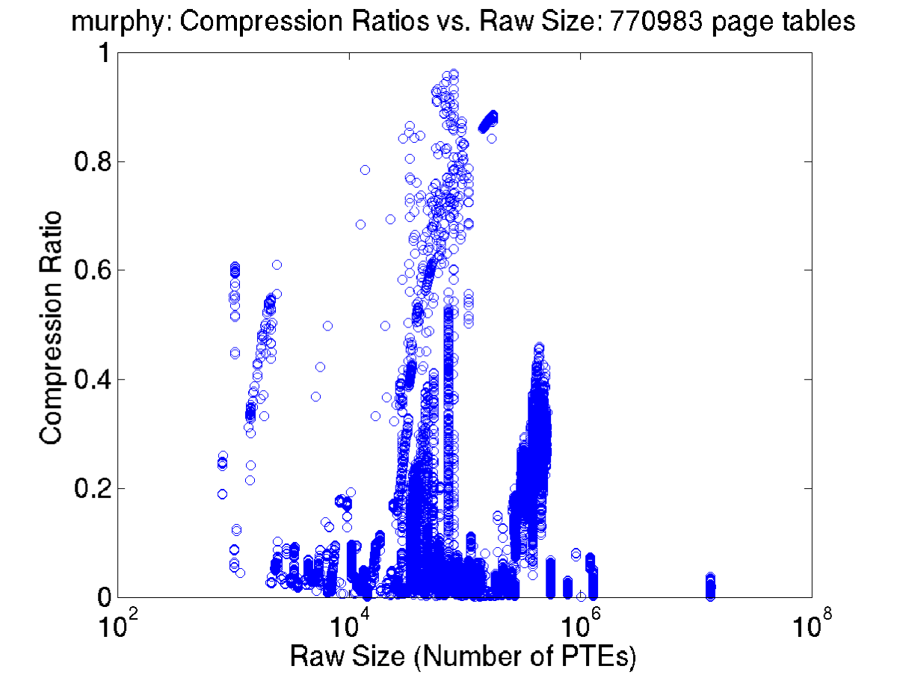
…but no relationship between size and compressibility
Oracle

Slide 17
Study
Overall results show mmap() will work fine for reconstructing guest process page tables in the shadow process
Observation: Kernel (and user code) already optimizes page placement for contiguity
  Side effect is the high compressibility noted here…
  Segments, etc, making comeback...

Slide 18
Security/Protection/Trust Achievable using Regular Unix/Linux/VMM mechanisms
Guest: No special privileges needed other
than access to its own abstract page table
Host: Dark shadow is a setuid root tool
VMM: No special privileges for dark shadow
Special privileges may be needed for
a particular service
Abstract page table discovery is already access controlled via /proc entries
Binding problem
  VM+guest process -> shadow process
Shadow process must have privilege to mmap /dev/mem (root, typically)
  setuid process -> this is a weakness
VMM’s GPA->HPA translation public to owner of VM and root, hence valid HPA range available
  Can avoid shadow mmaping() physical memory the guest does not own
… lots more in paper...
Notes:
Wall of words…

Slide 19
Framework Complexity
Component | Lines of C/ASM
Guest user (page table extraction) | ~850
Host user (dark shadow + capsule template) | ~800
VMM changes (existing host hypercall mech) | 0
VMM changes (existing GPA->HPA translation) | 0
Extracts page tables on the guest
Communicates page tables to the host
  Adding GPA->HPA layer
Reconstructs page tables on the host
Basic communication between guest and host
Template for building a service

Slide 20
System Call Forwarding Service
Component | Lines of C/ASM
Guest user (system call interception) | ~500
Host user (simple system call assembly stub) | ~160
VMM changes (existing host hypercall mech) | 0
Guest is where the subtlety is
  LD_PRELOAD library
  Constructor launches monitor thread
  Monitor thread attaches to parent using ptrace
Host just reissues the system call
Works fine
  Overhead of ptrace limits performance

Slide 21
System Call Forwarding and
Device File-level Device Virtualization
open(”/dev/hw”)
mmap(“/dev/hw”)
Address Space Changes
Guest
Kernel
Host
Kernel
User
Address Space Changes
User
Guest Virtual
Address Space
Host Virtual
Address Space
Guest Process
Shadow Process
Virtual Machine Monitor / Hypervisor
Host Kernel
Special Driver
Special HW
Any pointer in the guest process is valid in the shadow process

Slide 22
Device File-level Device Virtualization
Component | Lines of C/ASM
Guest user (system call interception) | ~500
Guest user (mmap reconstruction) | ~300
Host user (simple system call assembly stub) | ~160
Host user (mmap capture) | ~300
VMM changes (existing host hypercall mech) | 0
VMM changes (existing physical address space editor) | 0
Host address space mmap()s reflected back to both VMM and guest
VMM adds physical addresses as needed
Guest maps to those physical addresses

Slide 23
Status
System call forwarding service
  Fully functional
Device file-level device virtualization service
  Functional for simple I/O devices
  Partially functional for complex device (GPU)
    Near cryptographic protocol between NVIDIA user library and the driver blob
    Devil in the details with regard to other aspects of mating the two (e.g., /proc info, etc.)

Slide 24
Other Applications/Related Work
HVM and Multiverse (us)
  One virtual machine runs multiple kernels (Linux + special)
  Address space merging between Linux processes and special kernels
  Linux process can run as its own kernel while still leveraging devices/system calls supported by its native Linux kernel
  [HPDC 15, VEE 16, HPDC 16, in submission]
Pisces, XPMEM, and HIO (collaborators)
  One host runs multiple kernels without virtualization
  Named memory sharing between kernels
  Specialized kernels/processes can leverage devices/system calls supported by a native Linux kernel
  [HPDC 15, HPDC 15, SC 16, in submission]

Slide 25
Conclusions
Shadow process abstraction is a powerful tool for implementing virtualization services
  Not our innovation
We show it is feasible to implement it at user-level without guest or host kernel changes
  Our innovation
Arguably securely, with sufficient performance, and with tractable difficulty for the service implementer

Slide 26
For More Information
Peter Dinda
  pdinda@northwestern.edu
  http://pdinda.org
Akhil Guliani
  guliani@wisc.edu
  http://pages.cs.wisc.edu/~guliani/
Prescience Lab
  http://presciencelab.org
Palacios (including this code)
  http://v3vee.org
Acknowledgements
  Billy Gross, NSF, DOE

