Slide 1


Prospects for Shaping
User-centric Mobile Application Workloads to Benefit the Cloud
Maciej Swiech* Huaqian Cai⁺
Peter Dinda* Gang Huang⁺
*Northwestern University ⁺Peking University
empathicsystems.org
Notes:
25 minute time slot, so target 20-22 with room for questions
Tuesday, 9/20, 4:45-6pm, 3 talks, middle talk

Slide 2
Nutshell
Shaping traffic in mobile cloud applications
  Android application frontend <-> cloud backend
  Example: Shape request stream to be more Poisson
Insertable delay needed for most shaping
  More delay -> deeper queue -> more opportunity
Users can tolerate substantial inserted delays
  Delay tolerance envelope
  Up to 750 ms in our user study

Slide 3
Outline
What does inserted delay look like?
  More on “mobile cloud application”
Poisson arrival shaper example
  Why delay tolerance envelope matters
User study of delay tolerance envelope
  750 ms and other results
Poisson arrival shaping within the envelope
Preview of work since paper
Conclusions

Slide 4
Mobile Cloud Applications
Delay Inserted Here
Application Frontend
“The App” from “The Store”
User View
Frontend
Requests
Application
Backend
“Cloud”
Client
Device
Backend
Responses
Specifics here: Personally owned Android phones from 30 subjects
Widely used native binary (Java) apps from Google Play
User Pool

Slide 5
Mobile Cloud Applications
App | Request Rate (/s) | Request “Size”
MapQuest | 0.89 | Small
Pandora | 0.38 | Small
Pinterest | 1.63 | Medium
WeatherBug | 1.09 | Small
Google Translate | 0.46 | Large
Notes:
Mapquest instead of google maps – hash
We looked at top 25 and picked a variety of apps that we could instrument (more later)

Slide 6

What 750 ms Delay Looks Like
User interface for “native” apps typically runs asynchronously on the client
  Delayed requests do not necessarily manifest as UI disturbances
  Apps typically have considerable data to display, not just the result of one request
Arguably quite different from web applications and sites
  Where even tiny delays are perceived to have severe consequences

Slide 7
Poisson Arrival Shaping
Rate Estimator
Rate Estimator
Application Frontend
“The App” from “The Store”
PI Controller
User View
Frontend
Requests
μ
Application
Backend
“Cloud”
Client
Device
+ Exp. Dist. Random Delay
Backend
Responses
Specifics: Introduce delays drawn from exponential random distribution
while maintaining overall request rate (other versions in paper)
User Pool

Slide 8
Larger Delay Tolerance Envelope => Better Shaping
95th Percentile
Average
Specifics: simulation of system driven by traces from user study

Slide 9
Questions
What is the delay tolerance envelope of users of mobile cloud applications?
How is affected by application, user, demographics, and other factors
How can we expand the delay tolerance envelope?
  Mostly addressed in work since paper

Slide 10
User Study Details
Apps as shown previously (binaries taken from store)
30 participants familiar with apps, recruited campus-wide at Northwestern (IRBed), paid $40 for their time
  12 F, 18 M
  25 17-25, 5 25-35
  16 engineering, 10 liberal arts, 3 journalism, 1 education
  25 used smartphone for >6 months, 21 for >2 years
  Self-identified as a regular user of at least one of our apps
One week study, in the wild, on the users’
own personal phones
Carefully scripted entry and exit processes and documents

Slide 11
Within-app Interposition to
Introduce Delay and Acquire User Feedback
Original “App” Frontend
from the “Store”
DelayDroid / Dpartner
Toolchain
Added
Interface
Application Interface
Delay Inserted Here
Transformed Code
User View
Frontend
Requests
User View
Application
Backend
“Cloud”
Client
Device
Backend
Responses
Specifics here: DelayDroid/Dpartner Framework
Y Zhang, G Huang, X Liu, W Zhang, H Mei, S Yang, Refactoring Android Java Code for On-demand Computational Offloading, OOPSLA 2012
User Pool
H Cai, Y Zhang, M Swiech, G Huang, P Dinda, An Automated Framework for Reducing Tail Time Energy in Existing, Unmodified Applications, Science China Information Science (Accepted)

Slide 12
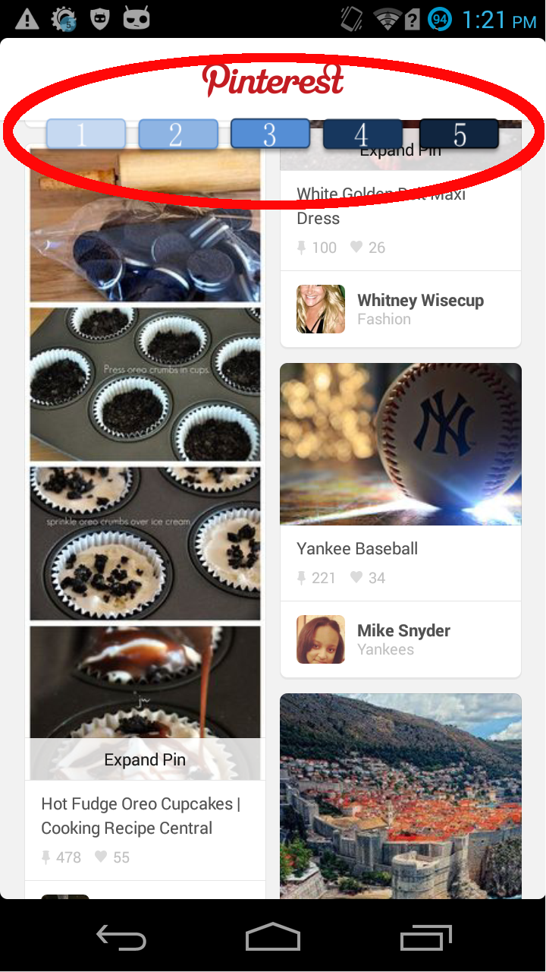
Interposition Details
User feedback interface
  Hovers over app
  Accepts input any time
  Blinks to prompt (user can ignore)
  “1 being completely dissatisfied, 5 being the most satisfied, and 3 being neutral [with/about performance]”
  Can also shake phone if irritated
Delay interposition
  110 networking functions in 5 categories of the Android API, including the high-level APIs
  Minimal overhead
Continuous data collection
  CPU, network, radio, power, …

Slide 13
Testcases
Arrivals at random times
Randomly chosen delay
  0 (placebo), 50, 250, 500, 750 ms
Delay applied for one minute
User prompted ( ) for satisfaction (1-5) 30 seconds into testcase
4560 total testcases, ~20% response rate,
850 total data points labeled with satisfaction
Pulsing Interface

Slide 14
Users Tolerate Significant Added Delay
Delay (ms) | Average Satisfaction (1-5) | p-value comparison to No Delay
No Delay | 4.08
50 | 4.10 | 0.002
250 | 4.12 | 0.001
500 | 3.94 | 0.022
750 | 4.20 | 0.005
Two one-sided t-test (TOST), null hypothesis: different
Threshold: 0.5; paired comparisons

Slide 15
Users Vary Considerably
Individual Bars
Do Not Matter
Variance Limits
Ability To
“Drill Down” with
statistical confidence

Slide 16
Observations
User tolerance for additional delay varies by application and user
  We think user is the key factor to capture, based on previous work
Real system might continuously measure individual user satisfaction and keep individual delay tolerance envelope on the verge of causing dissatisfaction
  Global feedback control

Slide 17
Poisson Arrival Shaping:
Is 750 ms Enough?
Rate Estimator
Rate Estimator
Application Frontend
“The App” from “The Store”
PI Controller
User View
Frontend
Requests
μ
Application
Backend
“Cloud”
Client
Device
+ Exp. Dist. Random Delay
Backend
Responses
Specifics: Introduce delays drawn from exponential random distribution
while maintaining overall request rate (other versions in paper)
User Pool

Slide 18
In Some Cases…
Before
After

Slide 19
In Some Cases…
Proof of concept: yes
But 750 ms not sufficient delay for most situations in our traces
Paper contains simulations for delaying individuals and for delaying aggregates
Before
After

Slide 20
Increasing Delay Tolerance
(work since paper; upcoming)
Direct Control Over Delay
  Study: 70 users at Peking U with Chinese equivalents of apps (in-lab study)
  Confirms 750 ms
M. Swiech, Controlling Green Users for a Happier Cloud, Doctoral Dissertation, NU-EECS-16-13 (Sept, 2016)

Slide 21
Increasing Delay Tolerance
(work since paper; upcoming)
Environmental Prompting
  Sustainability/energy story
  Study: 70 users at Peking U with Chinese equivalents of apps (in-lab study)
  Study: 300 users (U.S. and China) (video-based study on Mechanical Turk/SoJump)
  No Effect!
M. Swiech, Controlling Green Users for a Happier Cloud, Doctoral Dissertation, NU-EECS-16-13 (Sept, 2016)

Slide 22
Increasing Delay Tolerance
(work since paper; upcoming)
Peer Pressure
  User sets delay, can compare self with group
  Study: 20 users at Peking U with Chinese equivalents of apps (in-lab study)
  Study: 400 users (U.S.) (game-based study on Mechanical Turk)
  Some Effect
M. Swiech, Controlling Green Users for a Happier Cloud, Doctoral Dissertation, NU-EECS-16-13 (Sept, 2016)

Slide 23
Increasing Delay Tolerance
(work since paper; upcoming)
Virtue Signaling
  User sets delay
  Delay is individually visible to others
    “I am THIS green”
    Social network display
    Physical display on Northwestern “SmartWatch”
  Work in progress

Slide 24
Conclusion
Shaping traffic in mobile cloud applications
  Android application frontend <-> cloud backend
  Example: Shape request stream to be more Poisson
Insertable delay needed for most shaping
  More delay -> deeper queue -> more opportunity
Users can tolerate substantial inserted delays
  Delay tolerance envelope
  Up to 750 ms in our user study
Working to increase delay tolerance envelope

Slide 25
For More Information
Maciej Swiech’s Dissertation (NU-EECS-16-13)
Empathic Systems Project
  http://empathicsystems.org
Prescience Lab
  http://presciencelab.org
Peter Dinda
  pdinda@northwestern.edu
  http://pdinda.org
Maciej Swiech, Huaqian Cai,
Gang Huang
Notes:
See if diagrams make sense to non-participant
Slide #s

Slide 26
Users Vary Considerably
 | 0ms | 50ms | 250ms | 500ms | 750ms
MapQuest | 0.91 | 2.25 | 1.39 | 0.00 | 0.25
Pandora | 1.10 | 0.96 | 1.22 | 1.08 | 0.88
Pinterest | 1.08 | 1.49 | 0.95 | 0.89 | 2.06
WeatherBug | 0.88 | 1.96 | 1.65 | 1.41 | 1.64
Translate | 0.14 | 1.69 | 0.54 | 1.86 | 0.07

Slide 27
Phones of Participants
8 Samsung Galaxy S4
6 Samsung Galaxy S3
3 Nexus 5
2 Samsung Galaxy S2 (older)
2 Samsung Galaxy Nexus
Samsung Galaxy S5
Motorola X
Motorola G
Motorola Photon
LG D500
Nexus 4
HTC One M7
HTC Droid DNA
Sony Xperia MT27i

